Slide 1


Fundamentals of Management
Eleventh Edition
Chapter 3
Important Managerial Issues
Copyright © 2020, 2017, 2015 Pearson Education, Inc. All Rights Reserved

Slide 2
Learning Objectives
3.1 Explain globalization and its impact on organizations.
3.2 Describe what managers need to know about managing in global organizations.
3.3 Discuss how society’s expectations are influencing managers and organizations.
3.3 Discuss the factors that lead to ethical and unethical behavior in organizations.

Slide 3
Learning Objective 3.1
Explain globalization and its impact on organizations.

Slide 4
Globalization and Its Impact
Global village:
a boundaryless world where goods and services are produced and marketed worldwide.

Slide 5
What Does It Mean to Be "Global"?
Exchanging goods and services with consumers in other countries.
Using managerial and employee talent from other countries.
Using financial sources and resources outside home country.

Slide 6
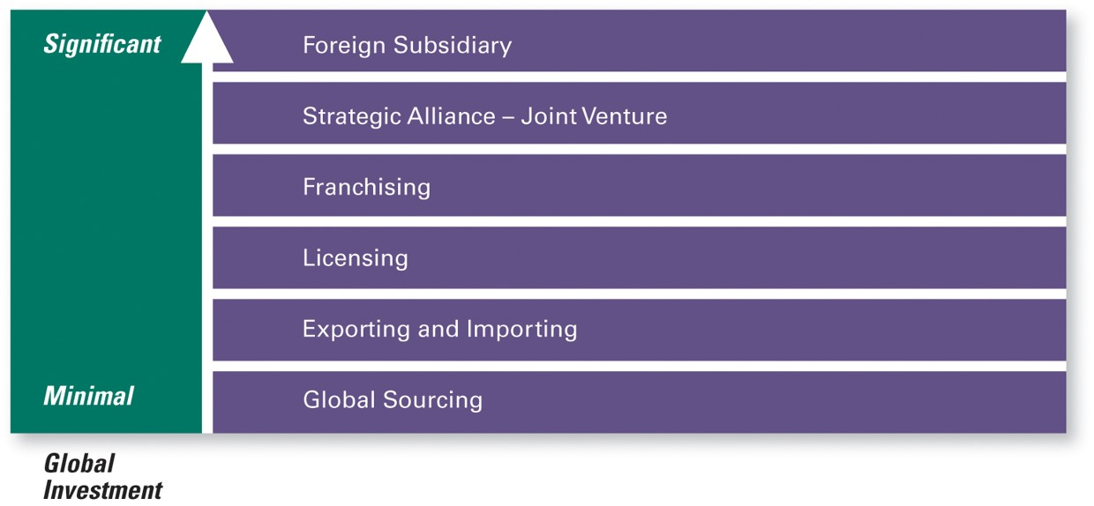
How Do Organizations Go Global?
Exhibit 3.1 How Organizations Go Global
Source: Robbins, Stephen P., Coulter, Mary, Management, 13th E d., © 2016, p. 106. Reprinted and electronically reproduced by permission of Pearson Education, Inc., New York, N Y.

Slide 7
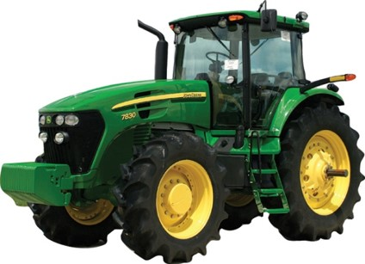

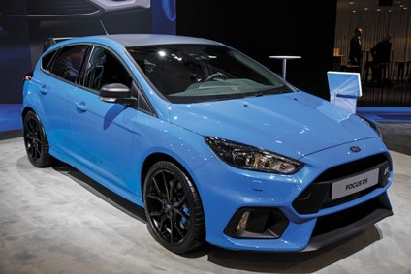
Types of Global Organizations
M N C (multinational corporation)
Multidomestic corporation
Transnational organization
Global corporation

Slide 8
Learning Objective 3.2
Describe what managers need to know about managing in a global organization.

Slide 9
Managing in a Global Organization
A person with a parochial attitude cannot succeed in today’s world.

Slide 10
Globe Findings
Global Leadership and Organizational Behavior Effectiveness (GLOBE)

Slide 11
Globe: Dimensions of Cultural Difference
Assertiveness
Future orientation
Gender differentiation
Uncertainty avoidance
Power distance
Individualism/Collectivism
In-group collectivism
Performance orientation
Humane orientation

Slide 12
Learning Objective 3.3
Discuss how society’s expectations are influencing managers and organizations.

Slide 13
Society’s Expectations
It’s an incredibly simple, but totally world-changing, idea.

Slide 14

Social Responsibility
Corporate social responsibility (C S R)
Social obligations
Social responsiveness

Slide 15
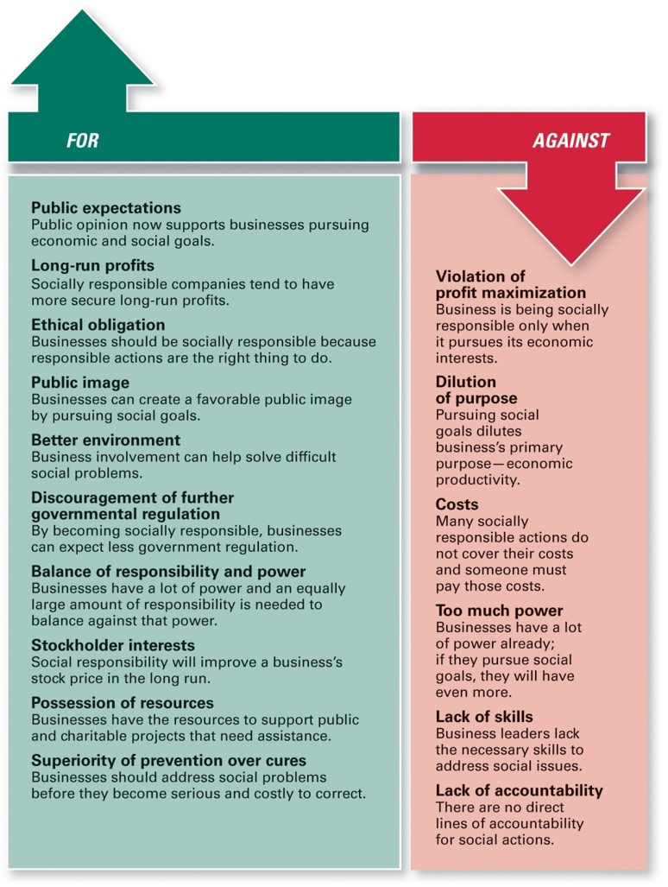
Arguments For and Against Social Responsibility
Exhibit 3.2 Arguments For and Against Social Responsibility
Source: Robbins, Stephen P., Coulter, Mary, Management, 13th E d., © 2016, p. 154. Reprinted and electronically reproduced by permission of Pearson Education, Inc., New York, N Y.

Slide 16
Does Social Involvement Affect Economic Performance?
Positive?
Negative?
Neutral?

Slide 17
What Is Sustainability?
Being green at the world’s largest retailer
$485.9 billion in revenues
2.3 million employees
11,700 + stores
Sustainability goal: Enhance the sustainability of operations and value chains.
Sustainability achievements: 26 percent of locations globally use renewable energy. 77 percent of global waste diverted from landfills. $200 billion worth of goods sold evaluated for sustainability performance.

Slide 18
Sustainability
Sustainability:
a company’s ability to achieve its business goals and increase long-term shareholder value by integrating economic, environmental, and social opportunities into its business strategies.

Slide 19
Learning Objective 3.4
Discuss the factors that lead to ethical and unethical behavior in organizations.

Slide 20
Ethical Behavior
Ethics:
a set of rules or principles that defines right and wrong conduct

Slide 21
Different Views of Ethics
Utilitarian view of ethics
Rights view of ethics
Theory of justice view of ethics

Slide 22
What Determines Ethical Behavior?
Morality
Values
Personality
Experience
Organization’s culture
Issue being faced

Slide 23
Encouraging Ethical Behavior
Code of ethics
Ethical leadership
Ethics training

Slide 24
Exhibit 3.3
Being an Ethical Leader
Be a good role model by being ethical and honest.
Tell the truth always.
Don’t hide or manipulate information.
Be willing to admit your failures.
Share your personal values by regularly communicating them to employees.
Stress the organization’s or team’s important shared values.
Use the reward system to hold everyone accountable to the values.

Slide 25
Ethics Training
Can ethics be taught?
Critics: value systems learned in youth.
Proponents: values can be learned and ethical problem solving increases ethical behavior, moral development, awareness.

Slide 26

Copyright
This work is protected by United States copyright laws and is provided solely for the use of instructors in teaching their courses and assessing student learning. Dissemination or sale of any part of this work (including on the World Wide Web) will destroy the integrity of the work and is not permitted. The work and materials from it should never be made available to students except by instructors using the accompanying text in their classes. All recipients of this work are expected to abide by these restrictions and to honor the intended pedagogical purposes and the needs of other instructors who rely on these materials.

